Slide 1
PROJECT BASED LEARNING
DATA ANALYTICS

Slide 2
PROJECT GOALS
Implementation of a Map­ Reduce based Context­ Aware Recommendation Engine for HEALTH CARE.

Slide 3
DATA SET
Data set contains health issues and details of the patients kept in a database
The data set is collected from different hospitals and health organizations.
The data set contains a total of approx. 100,000 entries.

Slide 4
ATTRIBUTES
First column : City_name
Second column : Hospital_name
Third column : Patient_id.
Fourth column : patient_name.
Fifth column : Patient_disease.
sixth column : Consulting_Doctor

Slide 5
DATA SET SAMPLE
“New York” “SOUTHEAST ALABAMA MEDICAL CENTER” 12341 “Clarke” “Diabetes” “Dr.Smith”
“New York” “SOUTHEAST ALABAMA MEDICAL CENTER” 13452 “Marsh” “Asthma” “Dr.Rose”
“Washington DC” “MARSHALL MEDICAL CENTER SOUTH” 24581 “Watson” “Diabetes” “Dr.Oliver”
“Seattle” “CRENSHAW COMMUNITY HOSPITAL” 50001 “Ivy” “Skin Disease” “Dr.Branson”

Slide 6
Software Requirement Specification
External Interface Requirements
1. User Interfaces
It will be simple and easy to understand. Controls which allow the user to interact with the application will be clear and imply their functionality within the application.
2. Hardware Interfaces
Password protected personal laptop
3. Software Interfaces
Inputs: The java program which takes the dataset, positive and negative words as the input and produces the list of the searched data as output.
4. Communication Interfaces:
Web browser and internet are required in order to make use of several functions and to be executed such as searching, viewing and downloading.

Slide 7
Functional Requirements
Data set is pre-processed using eclipse IDE to eliminate stop word and stemming is done
Data set pre-Processing: using Map Reduce algorithm.
The Map Reduce operates exclusively on < key, value>,that is the framework views the input to the job as a set of <key, value> pairs and produces set of <key, value> pairs as output.
The key and value classes have to be serializable by the framework and hence need to implement the Writable interface. Additionally, the key classes have to implement the Writable Comparable interface to facilitate sorting by the framework.

Slide 8
Software System Attributes
Reliability : The software will meet all of the functional requirements without any unexpected behavior
Availability : The software will be available on demand. The functionality of the software will not depend on any external services such as internet access that are required.
Security : The software will never disclose any personal information of Twitter users, and will collect no personal information from its own users.
Portability : This software is designed to run on any operating system.
Maintainability : The software should be written clearly and concisely. The code will be well documented. Particular care will be taken to design the software modularly to ensure that maintenance is easy.

Slide 9
Performance Requirements
Real-Time:
The software will provide up-to-date information, limited only by the rate of input. The output should display the latest results at all times, and if it lags behind, the user should be notified.
System Resource Consumption:
Resource consumption of this application should not reach an amount that affects the normal process of system. The application should be capable of operating in the background.

Slide 10
Database Requirement
The database supports functions to write, read and delete. The system shall support storage of huge amount of data.

Slide 11
Design Constraints
The database may affect system performance as data increases.
The accuracy of the polarity classifier may affect the final prediction accuracy

Slide 12
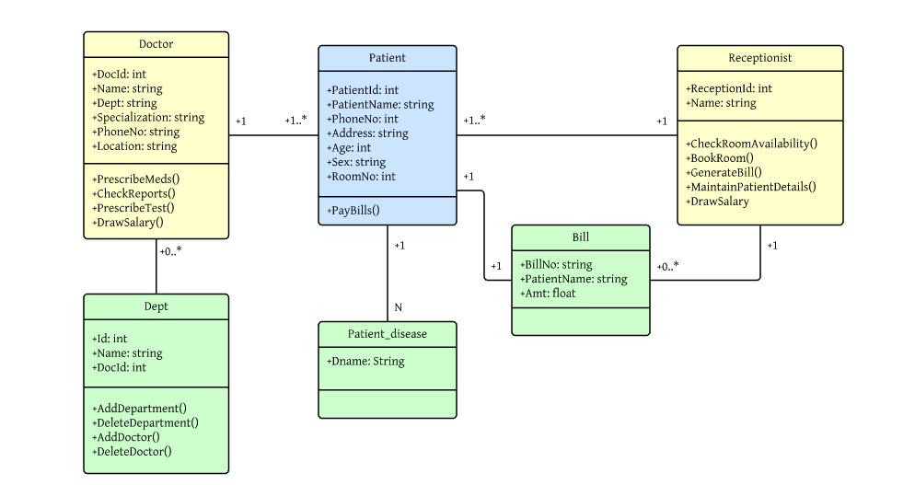
DESIGN ARCHITECTURE Class Diagram

Slide 13
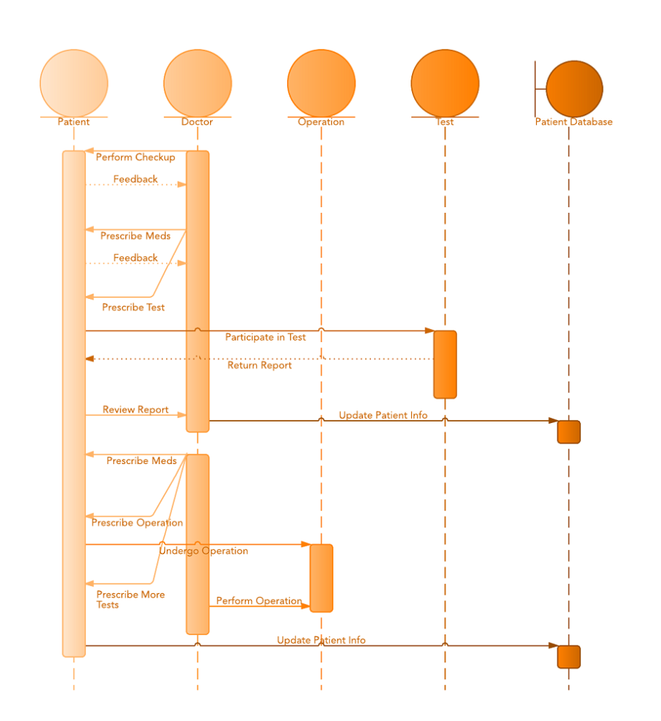
Sequence Diagram

Slide 14
IMPLEMENTATION DETAILS
A java code is developed which takes the dataset, positive and negative words as the input.
Input Output
The Map Reduce operates exclusively on < key, value>,that is the framework views the input to the job as a set of <key, value> pairs and produces set of <key, value> pairs as output
Map |  | <k1, v1> | list (<k2, v2>)
Reduce |  | <k2, list(v2)> | list (<k3, v3>)

Slide 15
Input and Output types of a Map Reduce job:
(Input)
<k1, v1> Map <K2, v2> combine <K2, v2> reduce <k3, v3>
(output)

Slide 16
Result
The combined and reduced data sample for managing health care solutions

Slide 17
Conclusion
Big data analytics has the potential to transform the way healthcare providers use sophisticated technologies to gain insight from their clinical and other data repositories and make informed decisions. In the future we’ll see the rapid, widespread implementation and use of big data analytics across the healthcare organization and the healthcare industry. Doctors can manage patients record anywhere in the world and updated record can be accessed by authorized doctors. Even normal persons can get the information about any kind of health issues and take precautions for particular issue. This project helps in teleconsultations by the doctors of the patients.

Slide 18
Bibliography
https://archive.org/download/twitter_cikm_2010
http://www.cloudera.com/content/www/enus/documentation/other/tutorial/CDH5/Hadoop-Tutorial/ht_example_4_sentiment_analysis.html
http://www-nlp.stanford.edu/courses/cs224n/2009/fp/3.pdf
http://www.ncbi.nlm.nih.gov/pmc/articles/PMC4224309/
http://www.google.com
https://highlyscalable.wordpress.com/2012/02/01/mapreduce-patterns/
http://www.tutorialspoint.com/hadoop/hadoop_mapreduce.htm
https://www.mapr.com/blog/how-write-mapreduce-program

Slide 19
THANK YOU

